Slide 1
Casco Bay Aquatics System (CBASS) Primer
Katie Lankowicz
QBC Interns 2025

Slide 2
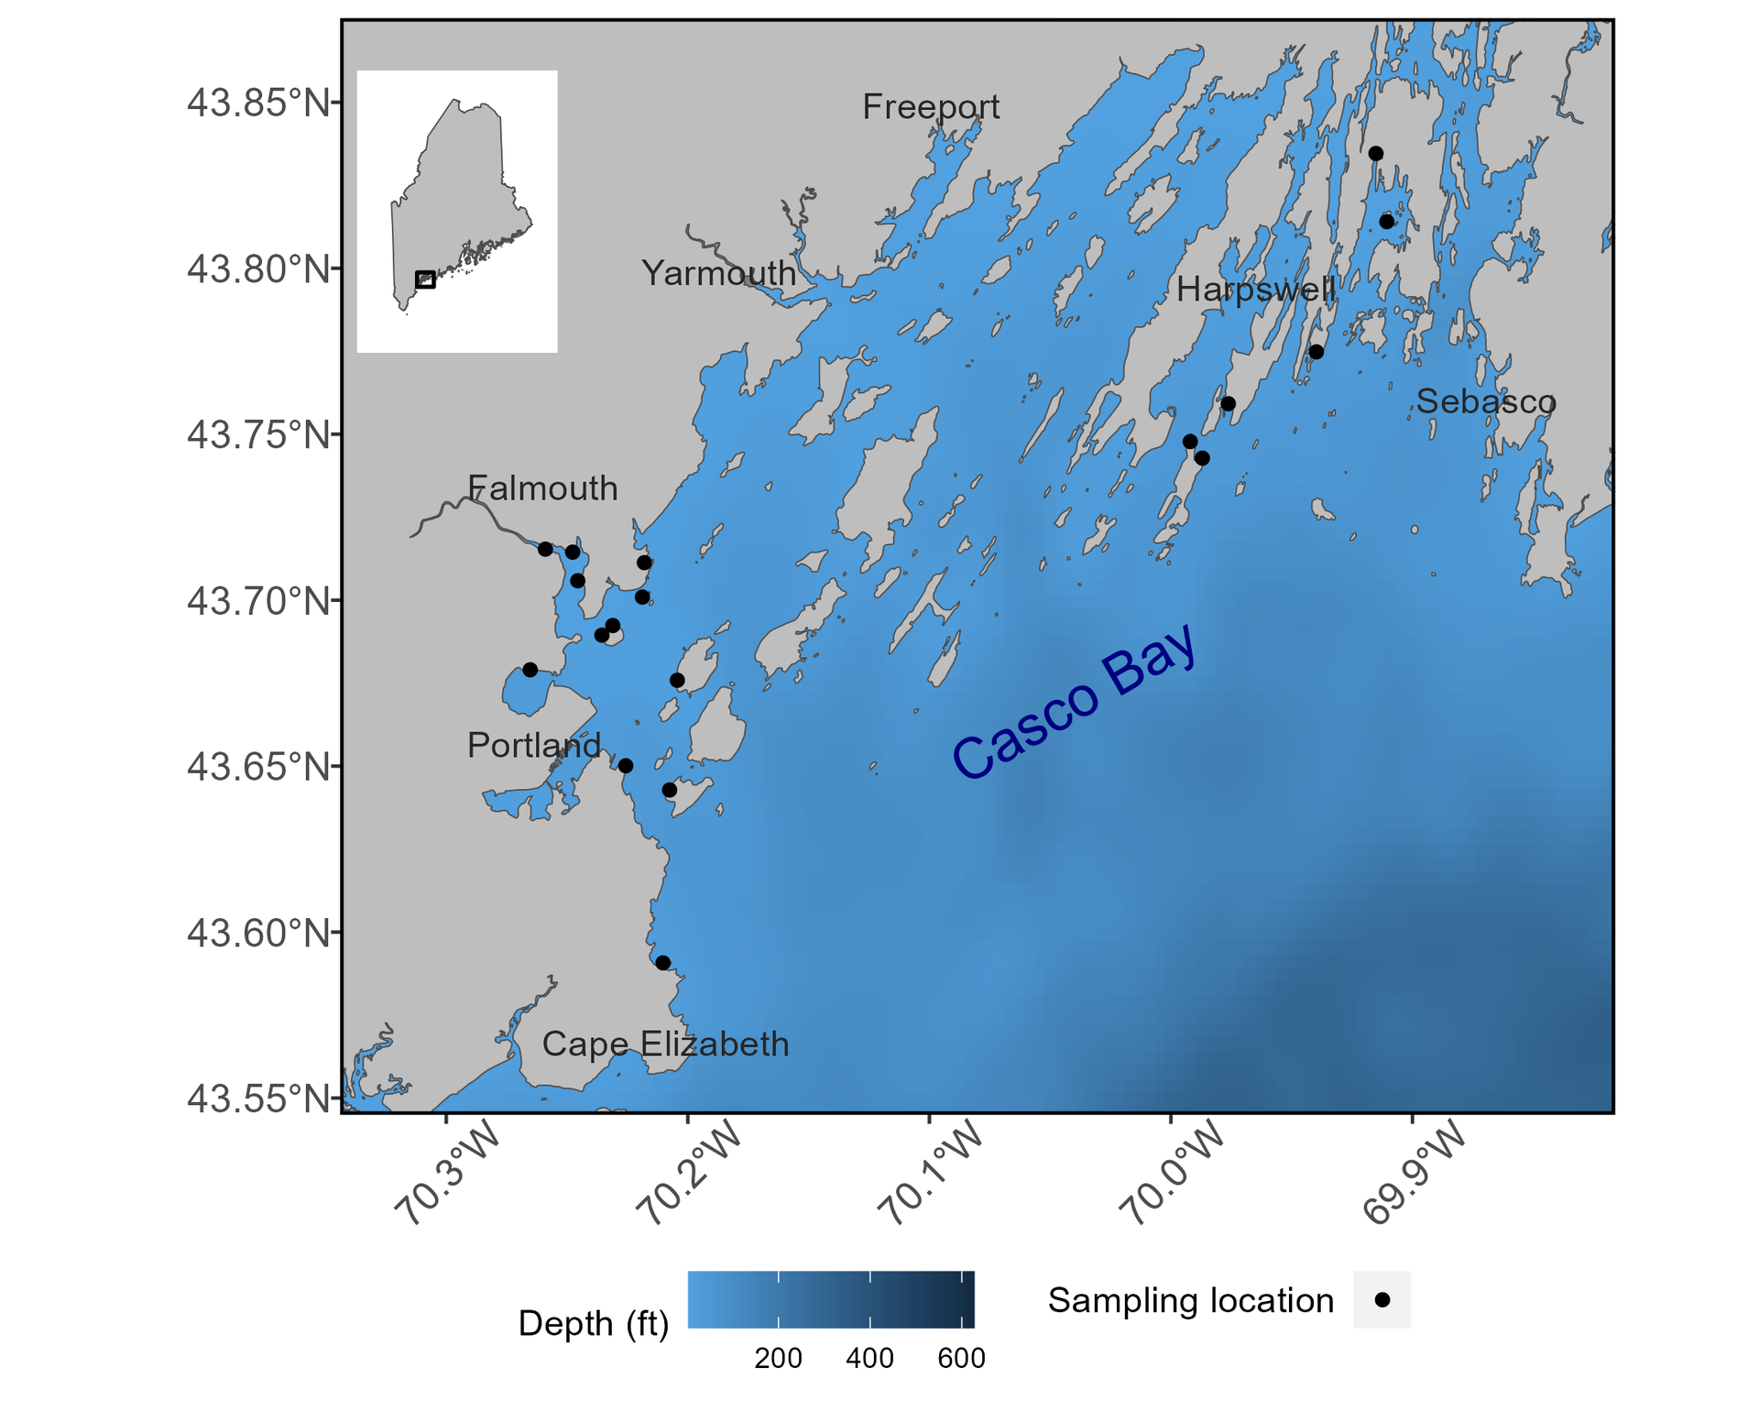
Casco Bay Aquatic Systems Survey (CBASS)
Began by Gulf of Maine Research Institute in 2014
Joined by sampling from the Quahog Bay Conservancy in 2023
Sparked by local climate change

Slide 3
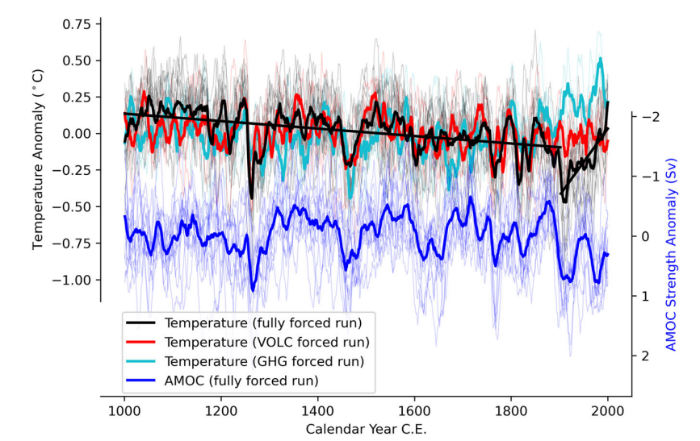
Gulf of Maine Climate Change
Instrumental records of local temperatures extend to the 1800s
We can extrapolate further by geochemical analysis or computational models
Results show 900 years of gradual cooling (1000-1880s CE) followed by 100 years of rapid warming

Slide 4
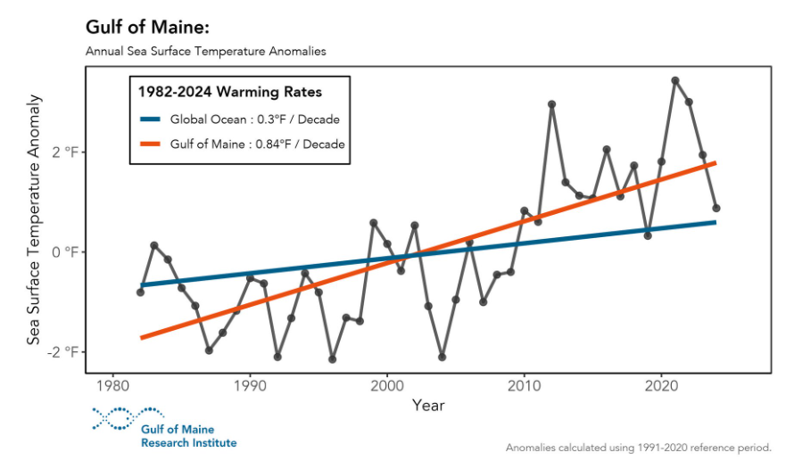
Gulf of Maine Climate Change
Since the 1980s, the Gulf of Maine has warmed at a rate ~3 times faster than the global average

Slide 5
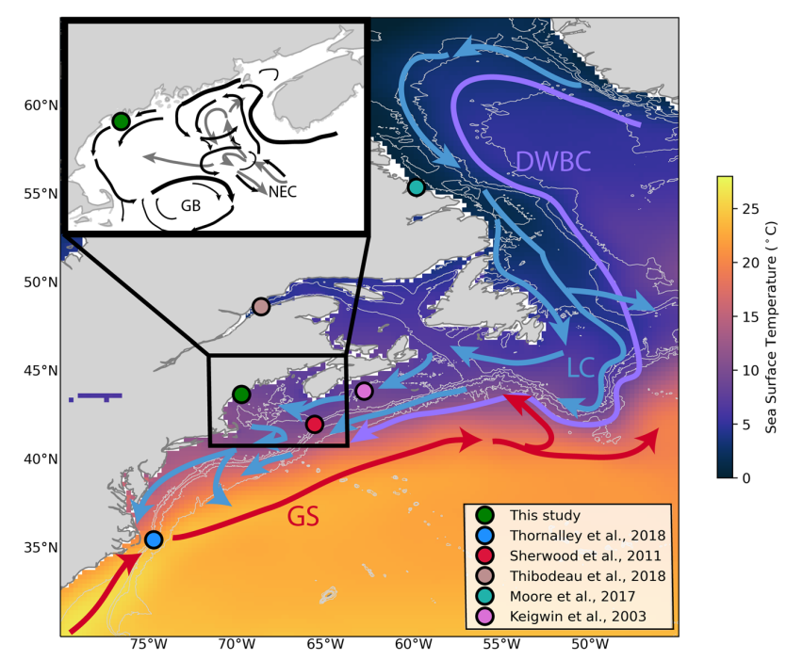
Gulf of Maine Climate Change
Mechanistically, warming of the Gulf of Maine waters is likely caused by shifts in relative influence of ocean currents
Exacerbated by the geology of the Gulf– shaped like a bathtub

Slide 6
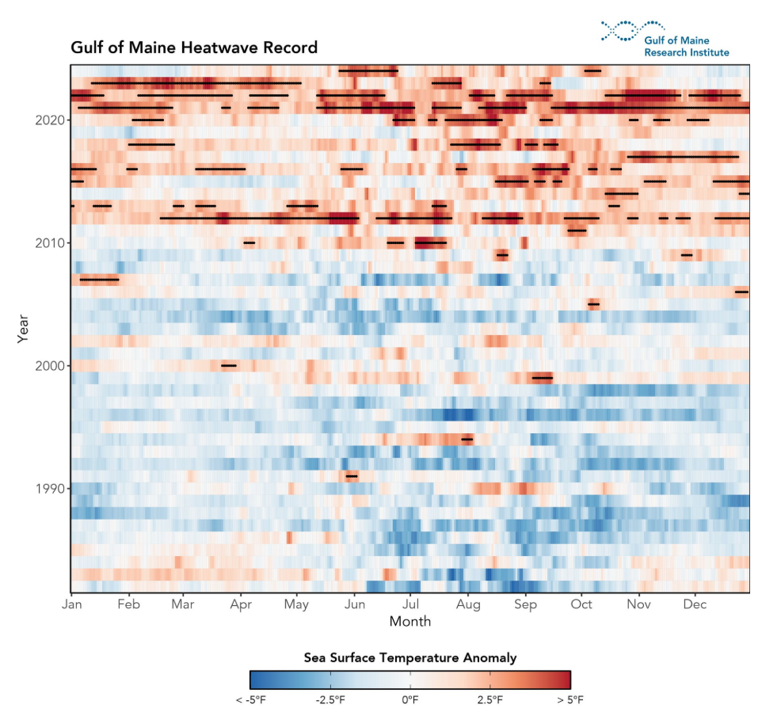
Gulf of Maine Climate Change
Marine heatwaves: extended periods of consistently above-average temperatures
North Atlantic Ocean recorded a massive, yearlong heatwave in 2012
North Carolina to Greenland, 2-5 degrees warmer than normal

Slide 7
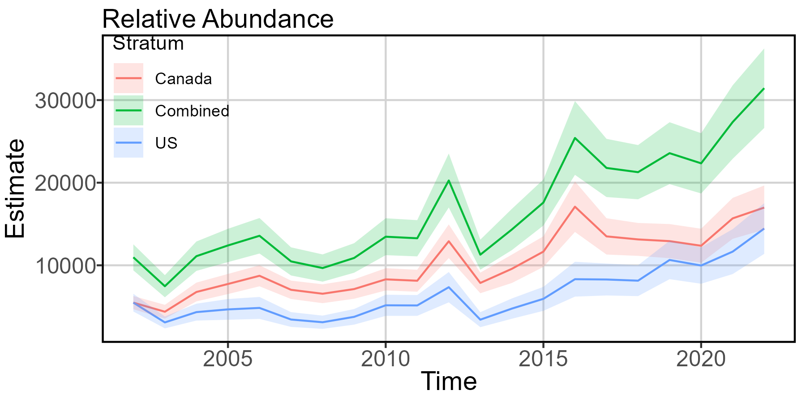
Ecological Effects
Bluefin tuna: Canada and US landings decreased the year after the heatwave
Probably due to a range shift in response to warming waters
Looking for optimum-temperature waters north and offshore

Slide 8
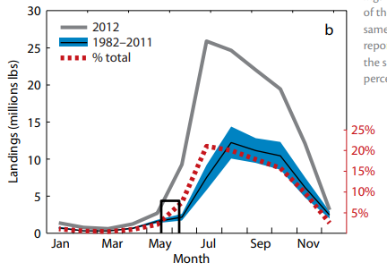
Ecological Effects
Lobsters: moved inshore sooner and molted faster
Resulted in more lobsters in easily-accessible areas, in turn causing record landings

Slide 9
Knowledge Gap
What is happening to the inshore community?

Slide 10
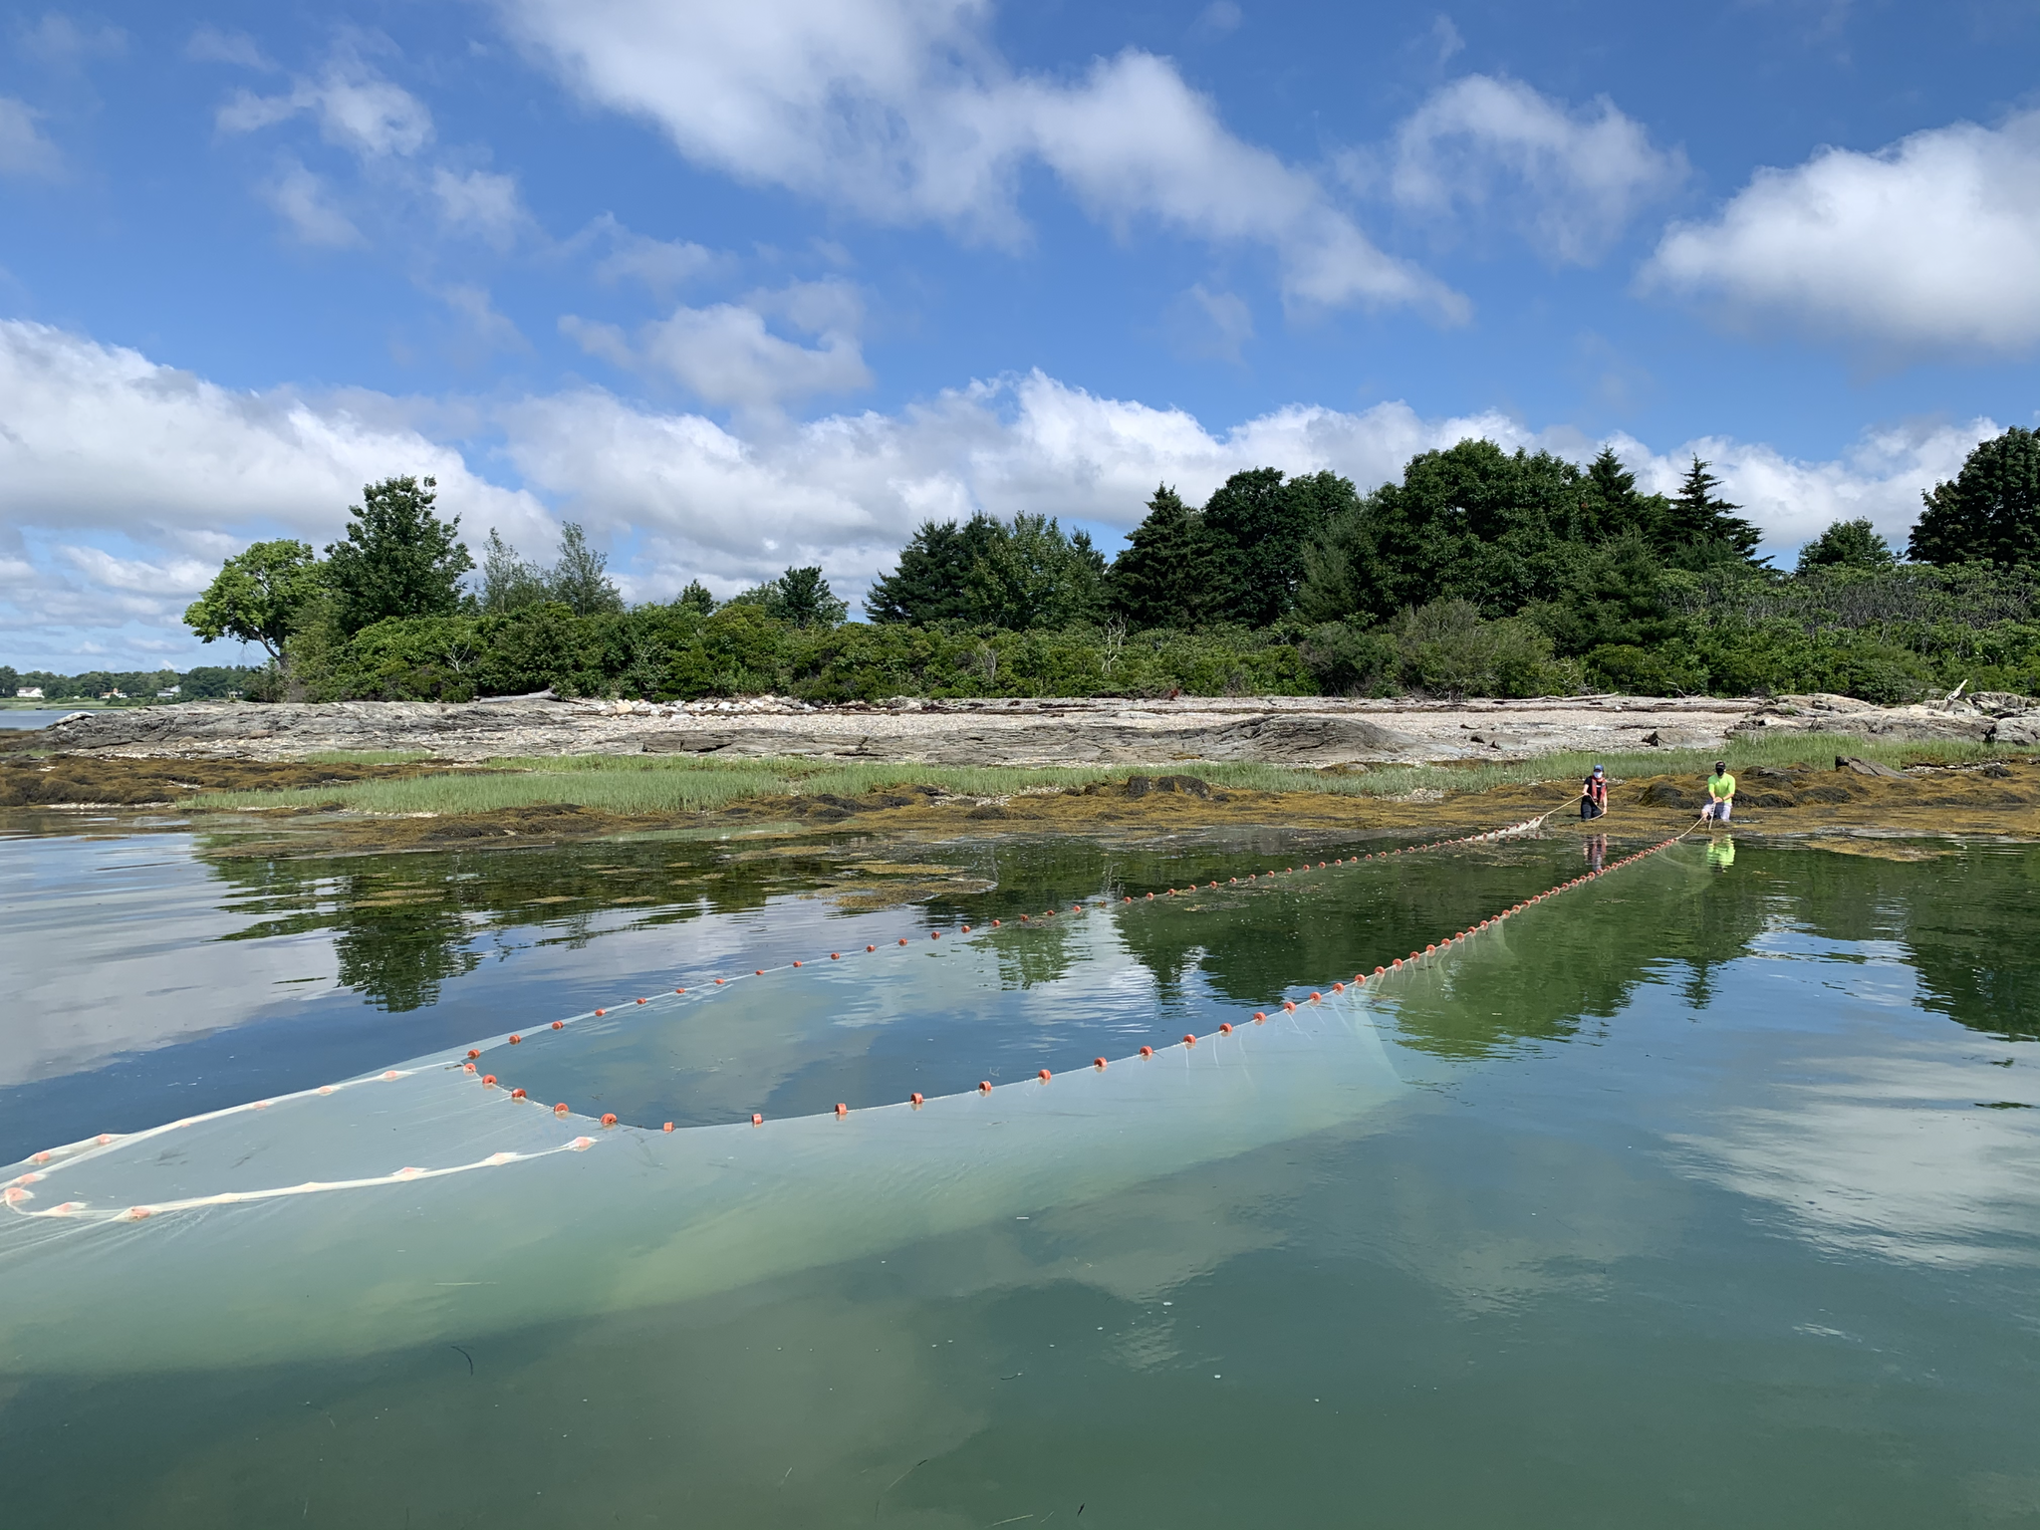
What we do
eDNA
Seining
Nearshore littoral community
Juvenile fishes
Diadromous fishes
Forage fishes
Nearshore temperature and salinity

Slide 11
eDNA/ YSI protocol
eDNA
Collect 3 1-L water bottles of surface water at each site
Approx 50 ft offshore
Back at the lab, filter to collect eDNA
Sonde (YSI)
Off the back of the boat when beached
Surface water

Slide 12
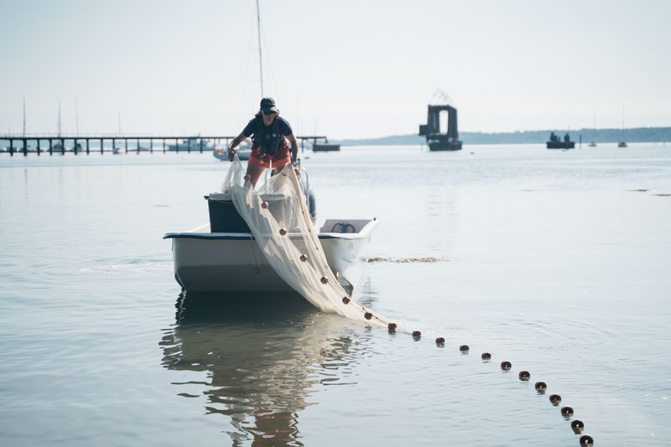
Seine Protocol
Front end off boat, one person on shore
Back boat offshore, circle around and land back end
Haul in by floatline
Examine fish in net
First 25 of each species get measured
More than 25, just count by species

Slide 13
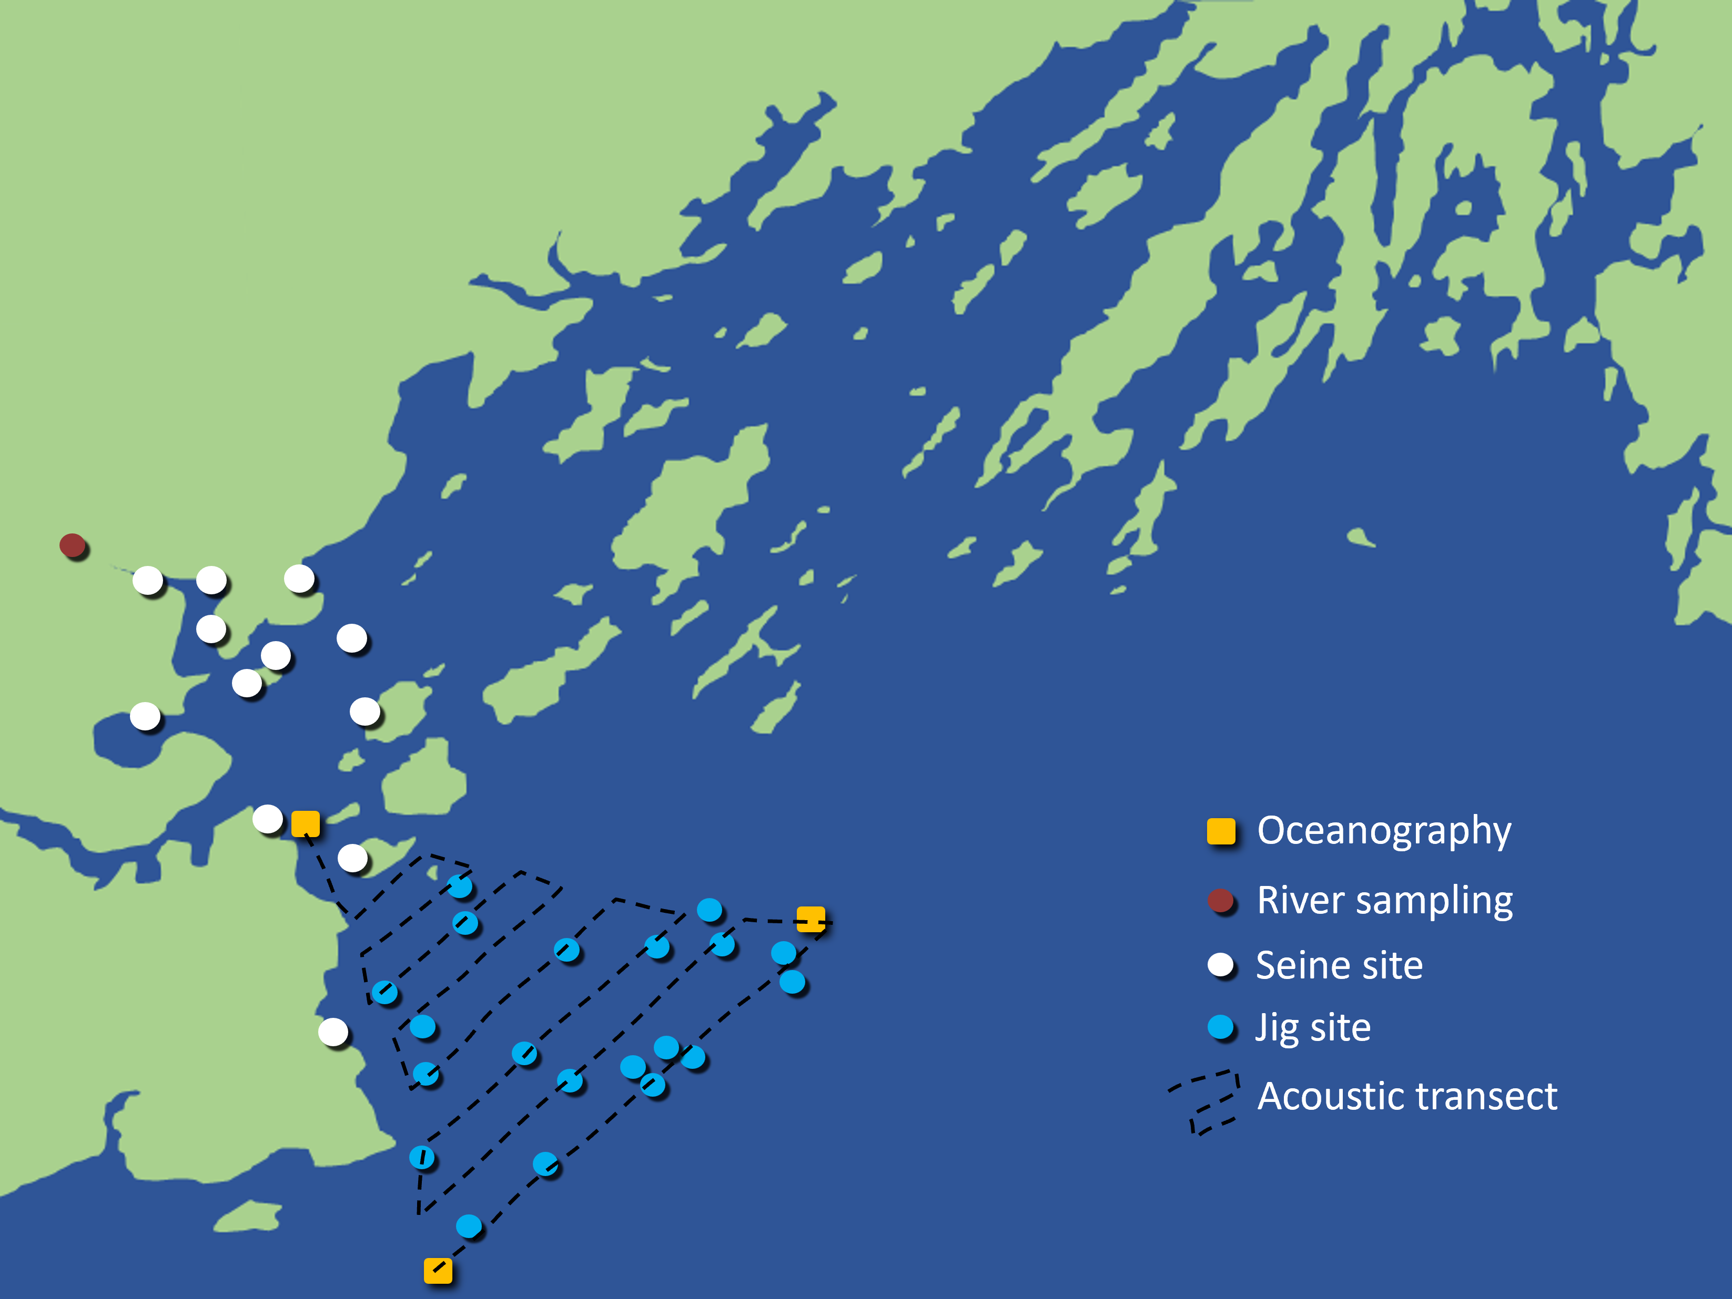
What GMRI will also do
Acoustics
Transect-based echosounder data to search for fish schools
Jigging
Traditional rod-and-reel fishing to sample larger fish
River Sampling
eDNA and cast net sampling for anadromous fishes

Slide 14
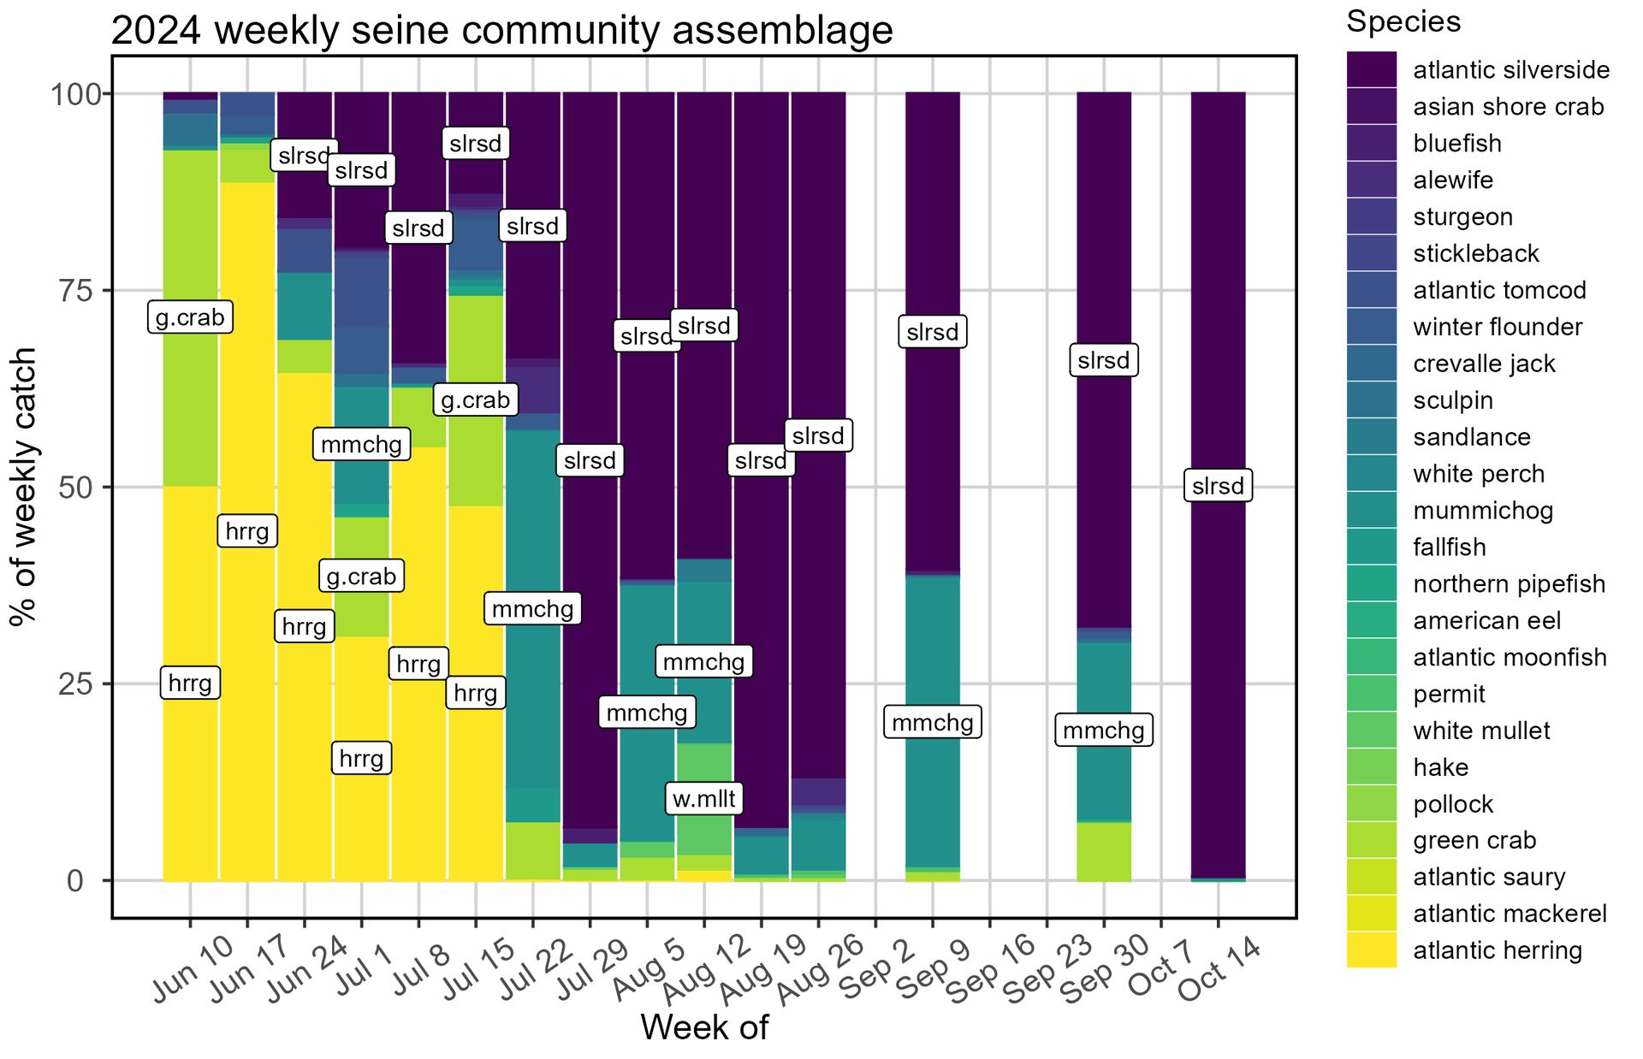
What we do with the data

Slide 15
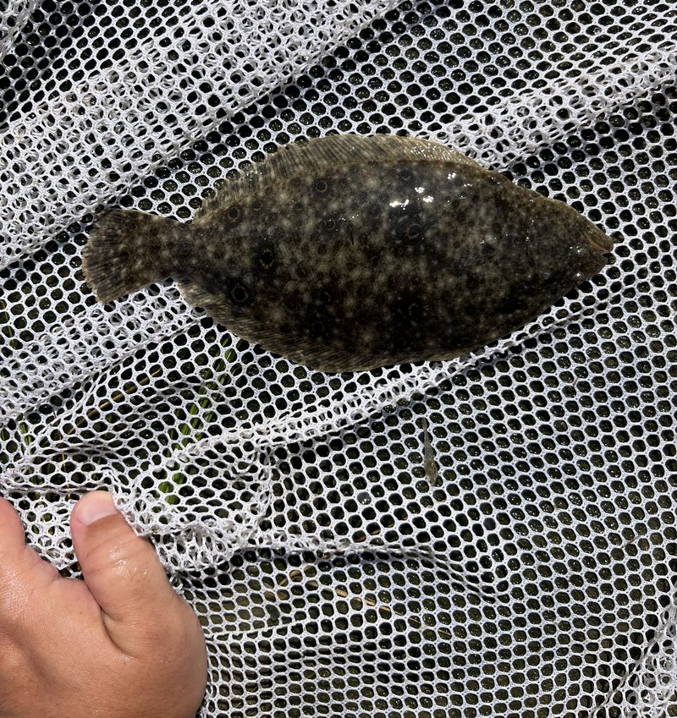
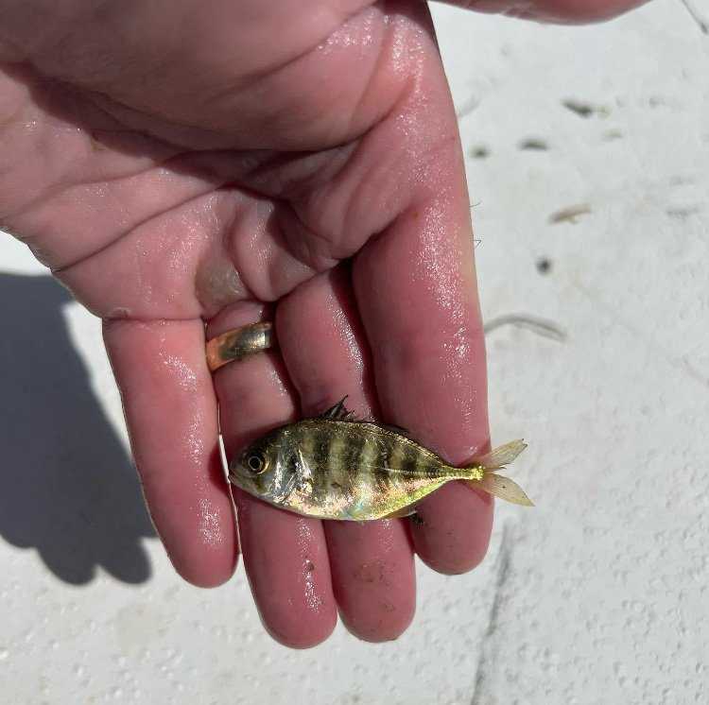
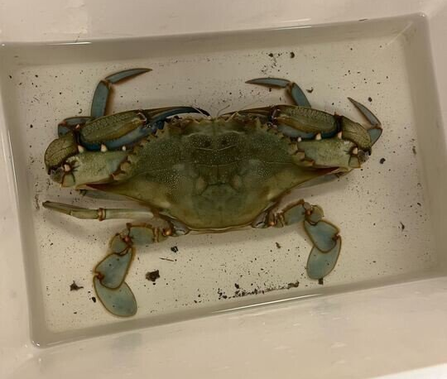
What we do with the data

Slide 16
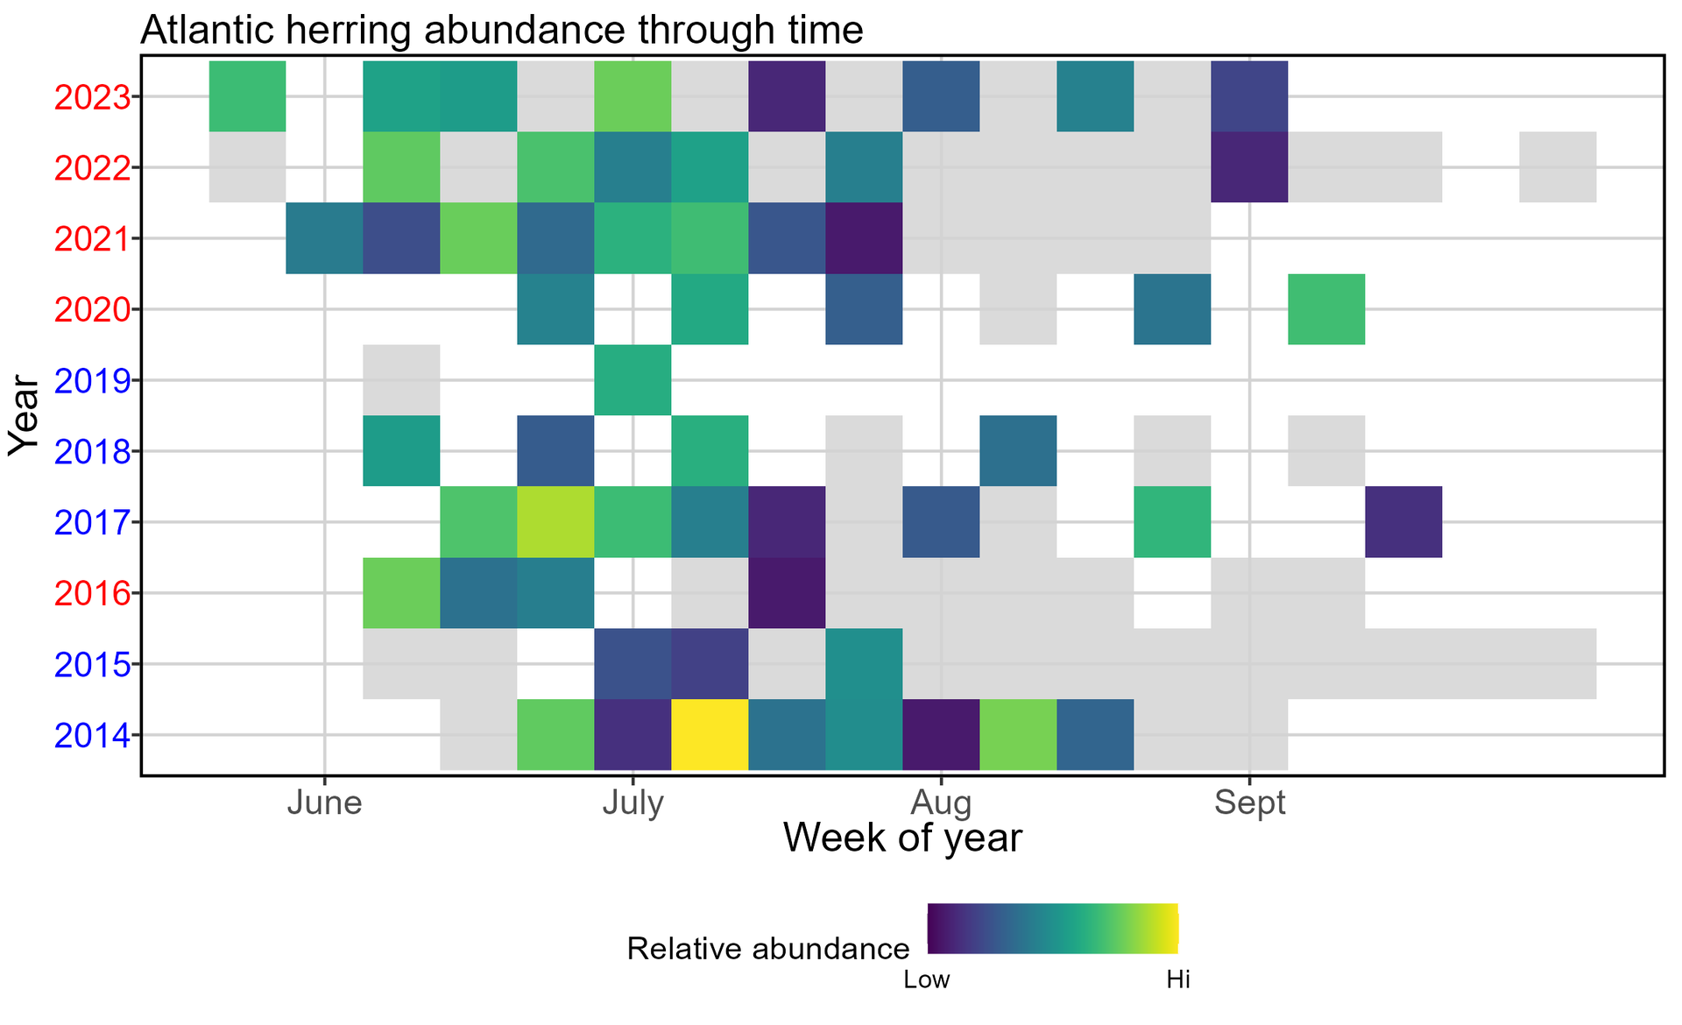
What we do with the data

Slide 17
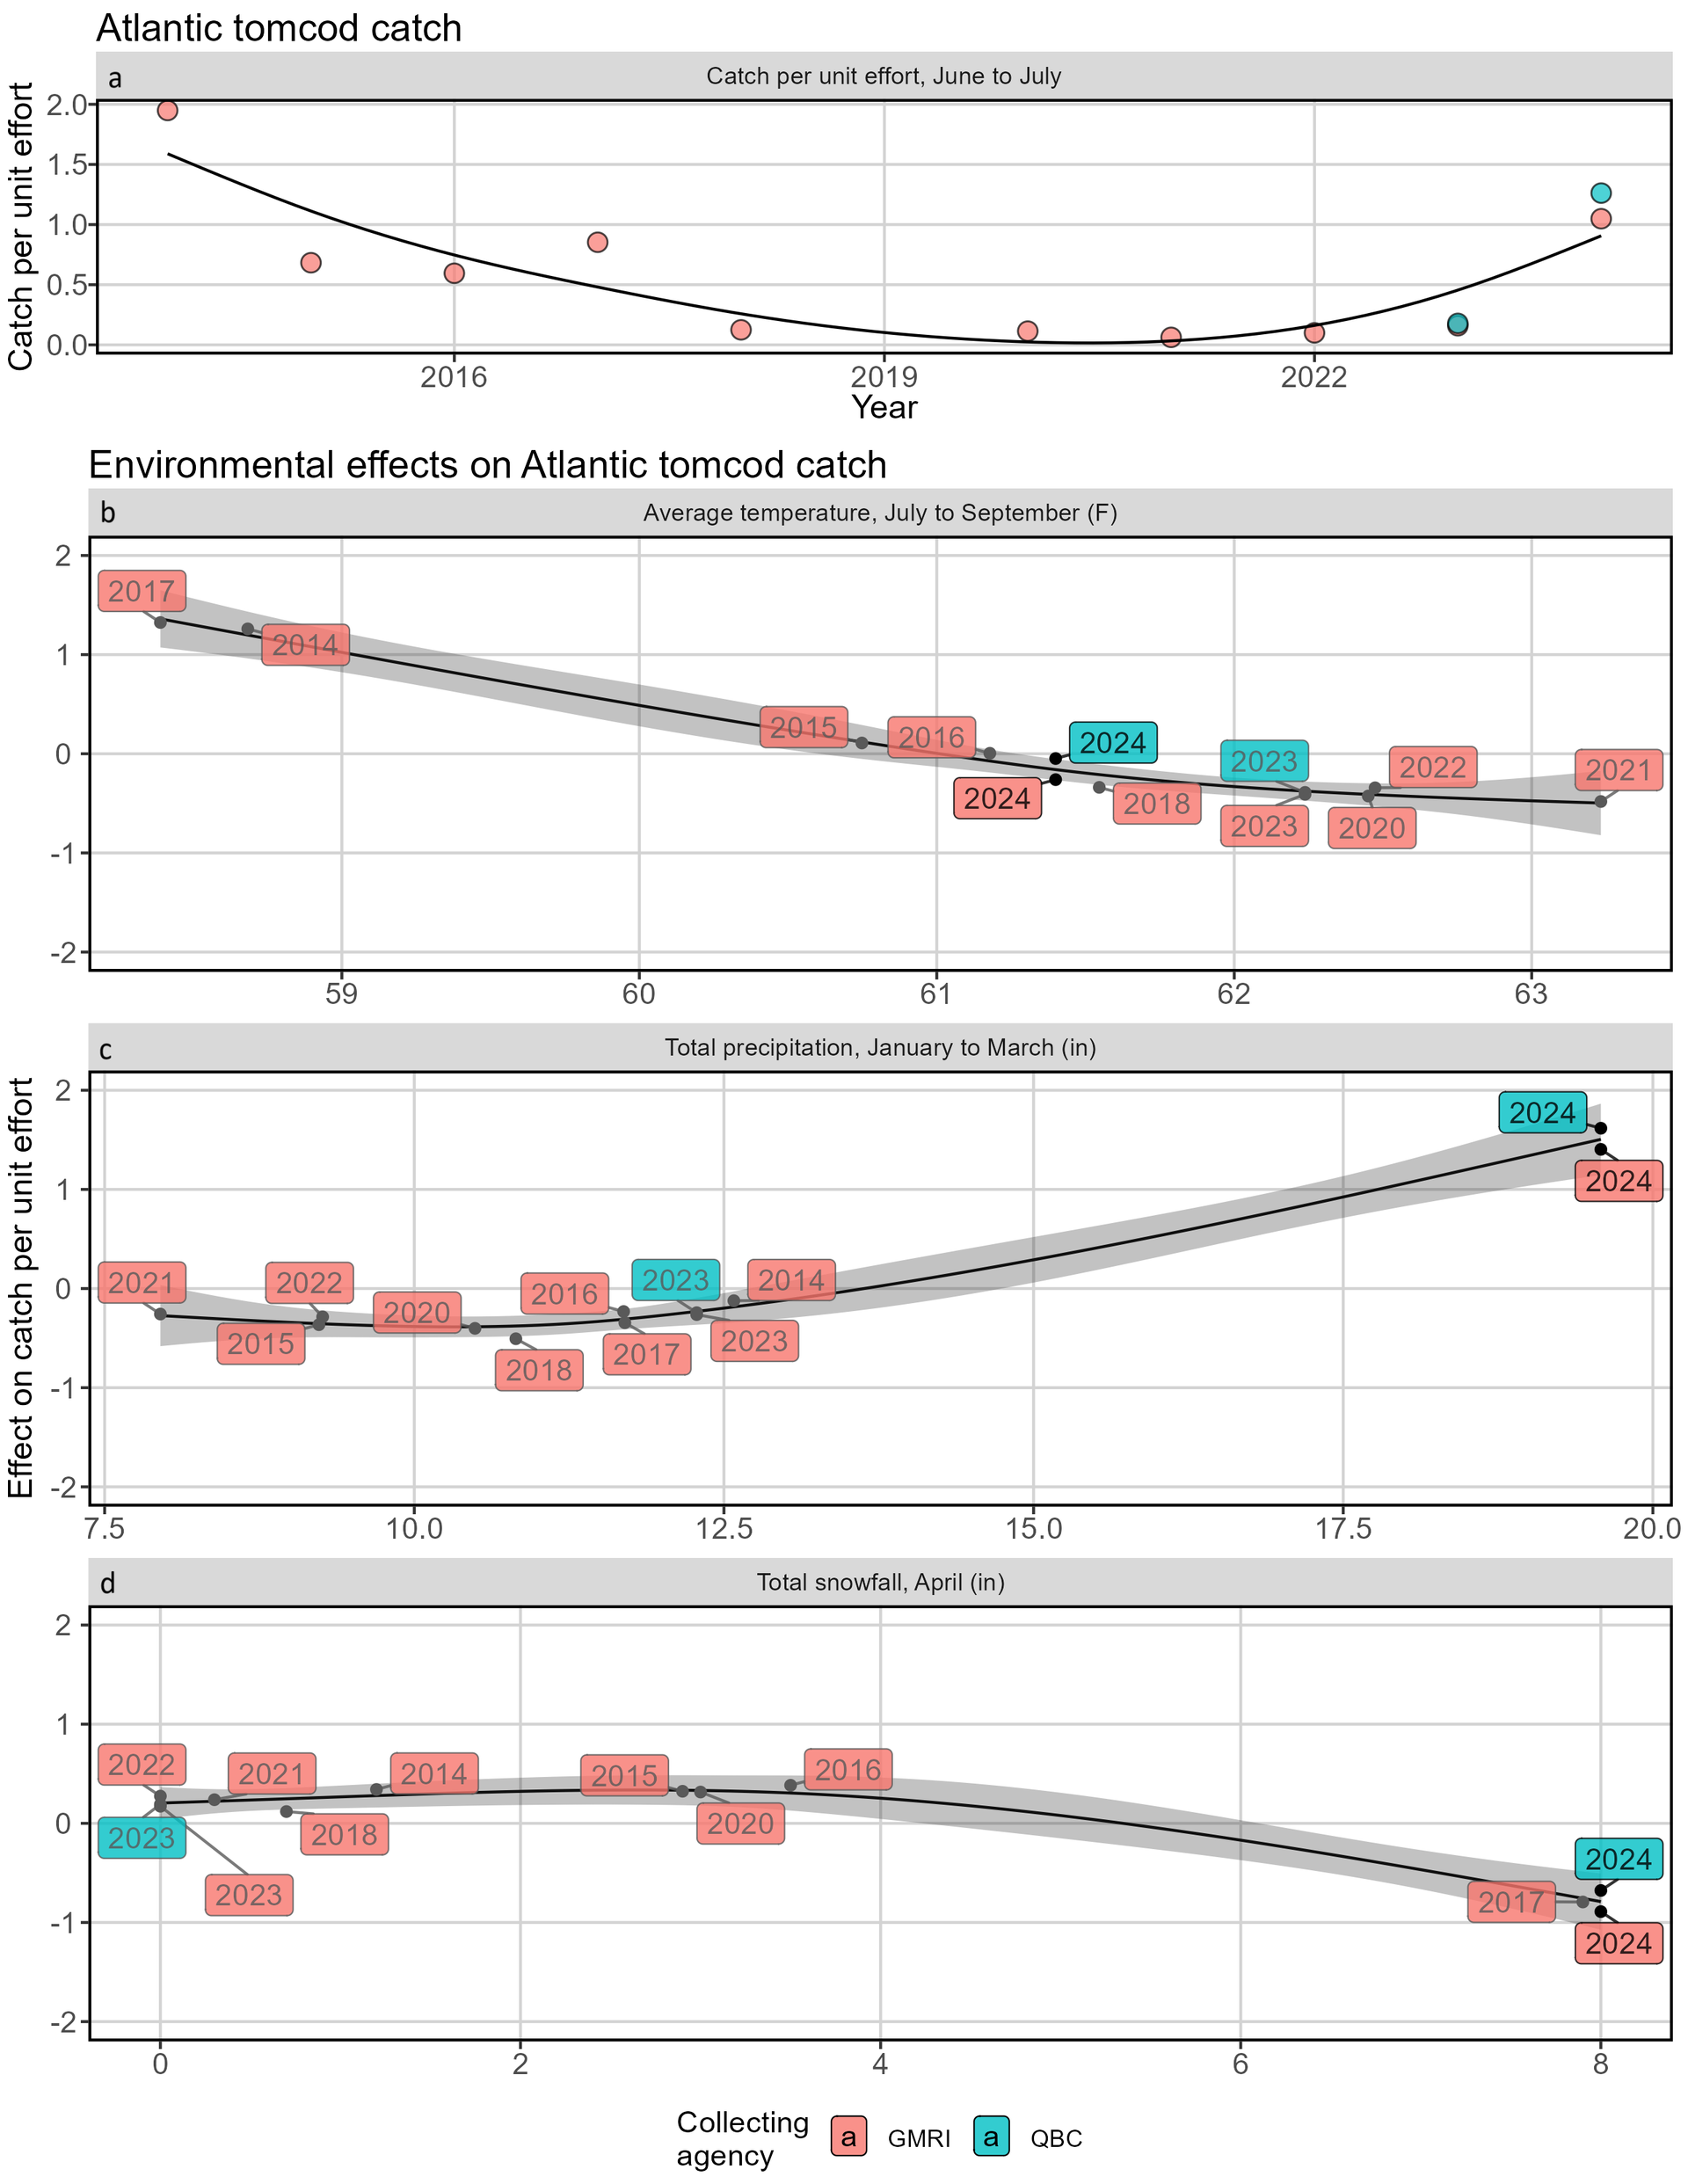

What we do with the data

Slide 18
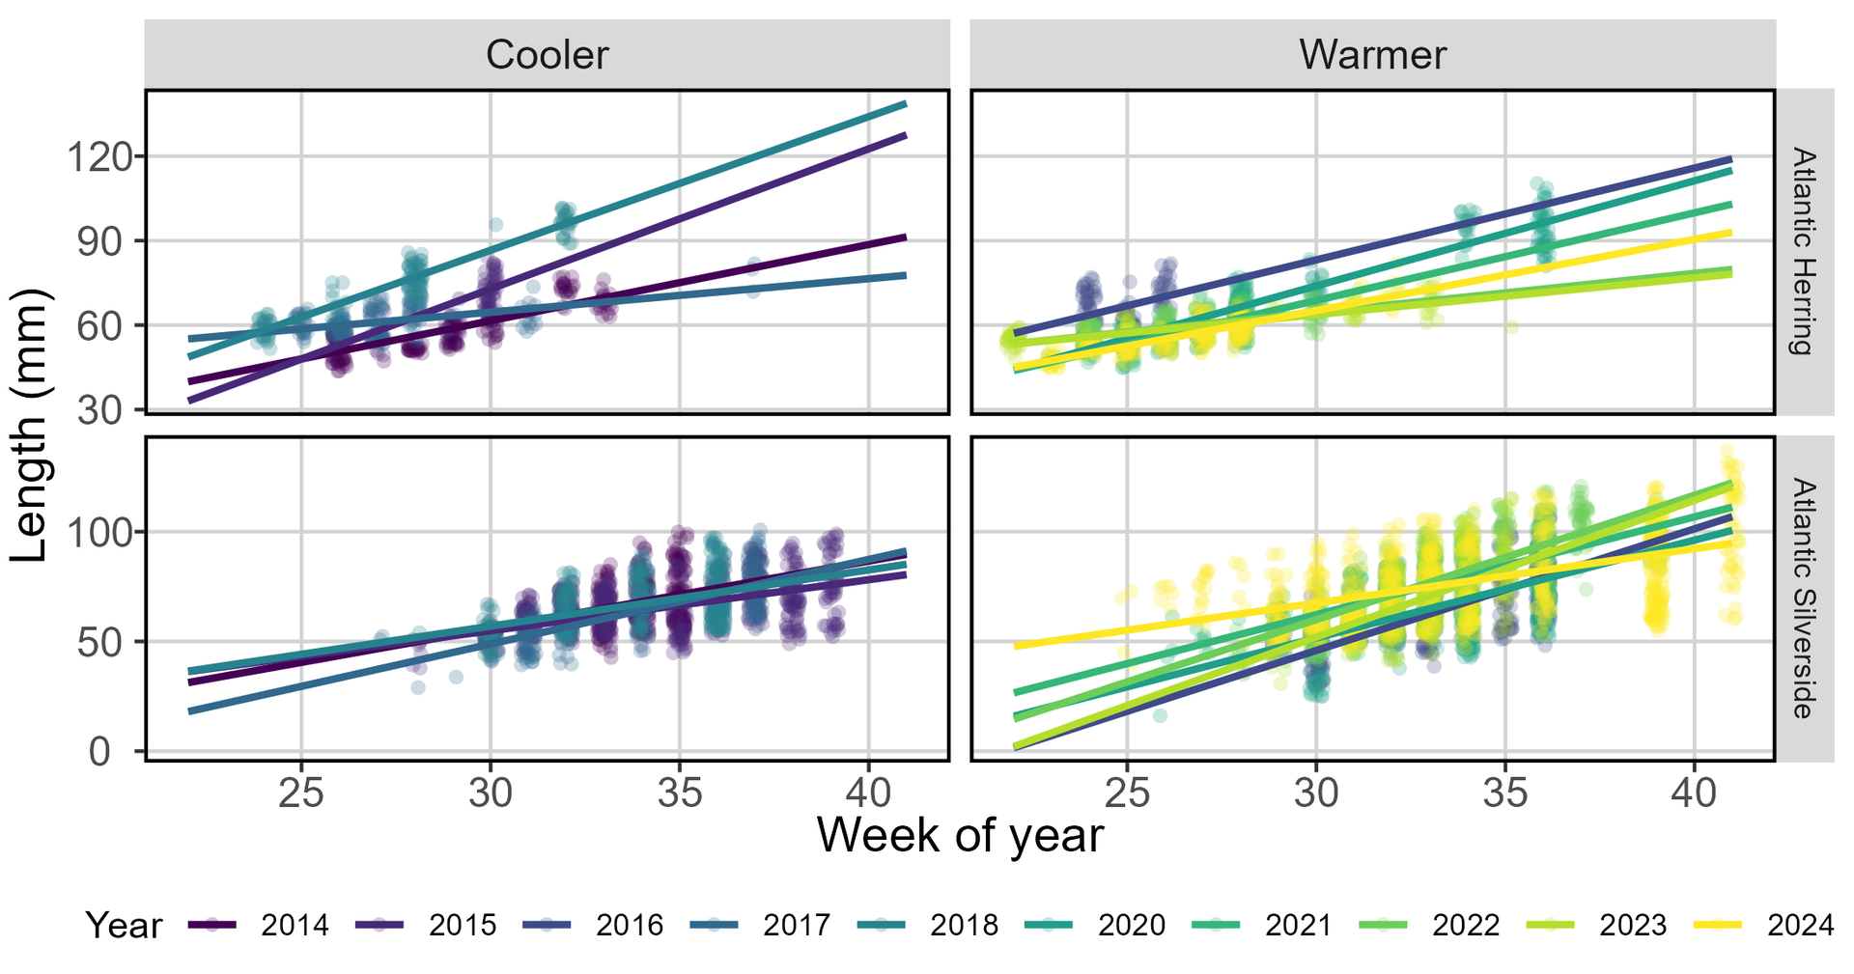
What we do with the data

